Slide 1
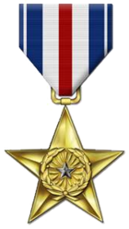
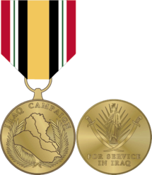
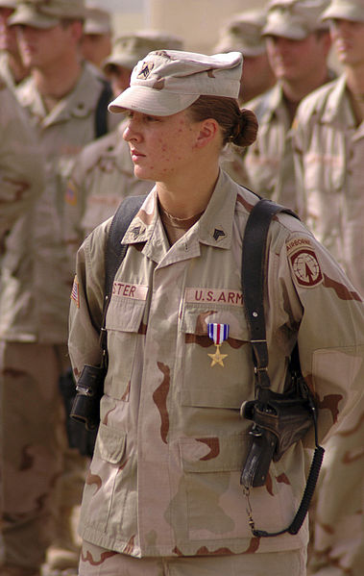
Sgt Leigh Ann Hester
Hester's squad (Military Police) was shadowing a 30-truck supply convoy when it was attacked in Salman Pak, Iraq. Hester maneuvered her team through the kill zone and into a flanking position while taking fire from AK-47 assault rifles, RPK machine guns and rocket propelled grenades (RPG). Sgt Hester and Sgt Nein then assaulted and cleared two trench lines which insurgents were using as cover. Sgt Hester shot 4 insurgents in the trenches at close range while clearing it. During the 25-minute firefight, the team was credited with 27 insurgents killed, six insurgents wounded, and one captured. Sgt Hester, Sgt Nein, and Spc Jason Mike (combat medic) were awarded Silver Stars for their valor in saving the convoy.
Also served in Afghanistan and currently an E-7
Hester after receiving her Silver Star medal during a military awards ceremony at Camp Liberty, Iraq.

Slide 2
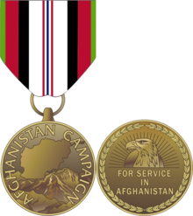
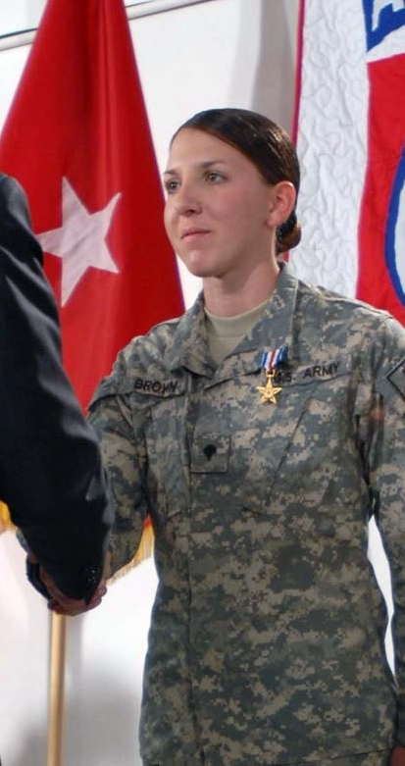
Pvt Monica Lin Brown
On 25 April 2007, 2d Platoon, Charlie Troop, 4th Squadron, 73d Cavalry Regiment, was on a combat patrol moving to Jani Khel, Afghanistan, for a leader engagement with the village elders. They were in a column formation moving north along Route VIPER. The trail vehicle, C23, struck a pressure plate IED on the driver's side rear tire, which ignited the fuel tank and fuel cans mounted on the rear of the vehicle. The explosion of the fuel tank and cans engulfed the vehicle in an intense fireball. This initiated a planned ambush which commenced after the explosion. The patrol began to take small arms fire, approximately 100 meters away. The small arms fire was impacting around the lead vehicle which was 300 meters north of the IED site. The small arms fire began to concentrate on the IED site as the Platoon Medic, then Private First Class (PFC) Brown, moved on foot to evaluate the casualties. She was exposed to the small arms fire until the maneuver element could swing around and begin suppressing the enemy as she treated the wounded Soldiers. After making an initial assessment and treating in order of severity, she moved the casualties with the aid of the Platoon Sergeant, into the wadi the engulfed vehicle was hanging over. The enemy fighters then engaged the patrol with mortar fire. PFC Brown threw her own body over the casualties to shield them as the mortars were impacting 75 meters away. Approximately 15 mortars impacted within close range of the casualties as PFC Brown continued treatment. PFC Brown continued treatment in the wadi 15 meters from the burning vehicle, at which time the onboard 60-mm mortar, 5.56-mm ammunition, and 40-mm grenade rounds on board began to explode. Again disregarding her own safety, PFC Brown shielded the casualties with her own body as large chunks of shrapnel and 5.56-mm rounds began flying through the air from the burning vehicle. The patrol leader arrived on site and found it incredible she was still alive and treating the casualties. Given the hazards to PFC Brown, the platoon sergeant used the Afghan National Army (ANA) Ford Ranger to move the wounded Soldiers and PFC Brown to a more protected position. As the truck began driving down the wadi, a large 60-mm mortar explosion occurred sending shrapnel flying all around where PFC Brown had been treating casualties. The platoon sergeant moved PFC Brown to a more protected position. PFC Brown continued treatment of the wounded Soldiers at the new site as enemy small arms fire began to impact the position. PFC Brown continued treatment of the casualties as the platoon returned fire in close vicinity of her. She shielded the wounded from falling brass and enemy fire once again, ensuring the casualties were stabilized and ready for MEDEVAC. Specialist Brown's heroic actions are in keeping with the finest traditions of military service, reflecting great credit upon herself, the 82d Airborne Division, and the United States Army.
Presented at Bagram Air Base, Afghanistan, by Vice President Dick Cheney, on March 21, 2008.
Full citation: http://ameddregiment.amedd.army.mil/silverstar/oifoef/oifoef1.html

Slide 3
Brown’s Citation (edited to fit on slide)
On 25 April 2007, 2d Platoon, Charlie Troop, 4th Squadron, 73d Cavalry Regiment, was on a combat patrol moving to Jani Khel, Afghanistan, for a leader engagement with the village elders. They were in a column formation moving north along Route VIPER. The trail vehicle, C23, struck a pressure plate IED on the driver's side rear tire, which ignited the fuel tank and fuel cans mounted on the rear of the vehicle. The explosion of the fuel tank and cans engulfed the vehicle in an intense fireball. This initiated a planned ambush which commenced after the explosion. The patrol began to take small arms fire, approximately 100 meters away. The small arms fire was impacting around the lead vehicle which was 300 meters north of the IED site. The small arms fire began to concentrate on the IED site as the Platoon Medic, then Private First Class (PFC) Brown, moved on foot to evaluate the casualties. She was exposed to the small arms fire until the maneuver element could swing around and begin suppressing the enemy as she treated the wounded Soldiers. After making an initial assessment and treating in order of severity, she moved the casualties with the aid of the Platoon Sergeant, into the wadi the engulfed vehicle was hanging over. The enemy fighters then engaged the patrol with mortar fire. PFC Brown threw her own body over the casualties to shield them as the mortars were impacting 75 meters away. Approximately 15 mortars impacted within close range of the casualties as PFC Brown continued treatment. PFC Brown continued treatment in the wadi 15 meters from the burning vehicle, at which time the onboard 60-mm mortar, 5.56-mm ammunition, and 40-mm grenade rounds on board began to explode. Again disregarding her own safety, PFC Brown shielded the casualties with her own body as large chunks of shrapnel and 5.56-mm rounds began flying through the air from the burning vehicle. The patrol leader arrived on site and found it incredible she was still alive and treating the casualties. Given the hazards to PFC Brown, the platoon sergeant used the Afghan National Army (ANA) Ford Ranger to move the wounded Soldiers and PFC Brown to a more protected position. As the truck began driving down the wadi, a large 60-mm mortar explosion occurred sending shrapnel flying all around where PFC Brown had been treating casualties. The platoon sergeant moved PFC Brown to a more protected position. PFC Brown continued treatment of the wounded Soldiers at the new site as enemy small arms fire began to impact the position. PFC Brown continued treatment of the casualties as the platoon returned fire in close vicinity of her. She shielded the wounded from falling brass and enemy fire once again, ensuring the casualties were stabilized and ready for MEDEVAC. Specialist Brown's heroic actions are in keeping with the finest traditions of military service, reflecting great credit upon herself, the 82d Airborne Division, and the United States Army.

